Slide 1

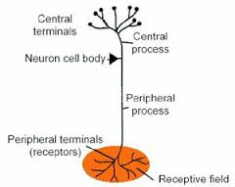
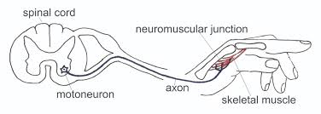
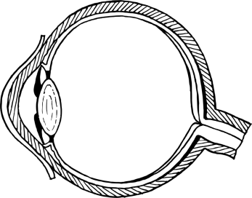


Visual Cortex
r = spikes/θ
Control System
(Organism)
e = spikes/N
p = spikes/θ
Environment
(Reality)
Receptive Field
o (cm/N)
Feedback Function
(Laws of Physics and Optics)
d (θ)
x
θ
y
Qi = θ = sin⁻¹(x/y)

Slide 2
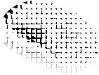

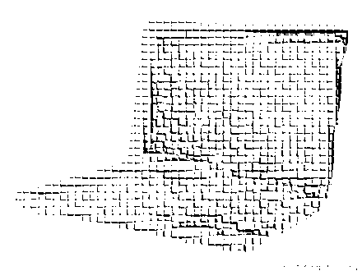
Visual Cortex
r = spikes/θ
Control System
(Organism)
e = spikes/N
p = spikes/θ
Environment
(Reality)
Receptive Field
o (cm/N)
Feedback Function
(Laws of Physics and Optics)
d (θ)
x
θ
y
Qi = θ = sin⁻¹(x/y)

